Slide 1



STRATEGIC COMMUNICATION AND EXECUTIVE NEGOTIATION
LLOYD C. ROSQUITA EdD
Chief Education Supervisor
RO1-SDOIN-F35-02-00
Effectivity Date: May 11, 2020
“Ragsak ken Rag-omi ti Napudno nga Agserbi”
RO1-SDOIN-F35-02-00
Effectivity Date: May 11, 2020

Slide 2
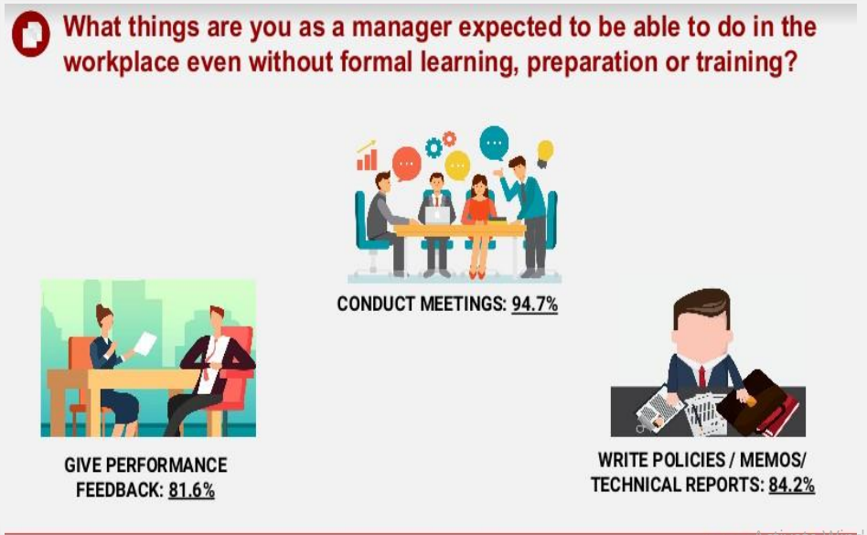
SCHOOLS DIVISION OF ILOCOS NORTE
RO1-SDOIN-F35-02-00
Effectivity Date: May 11, 2020
TITLE OF THE PRESENTATION

Slide 3
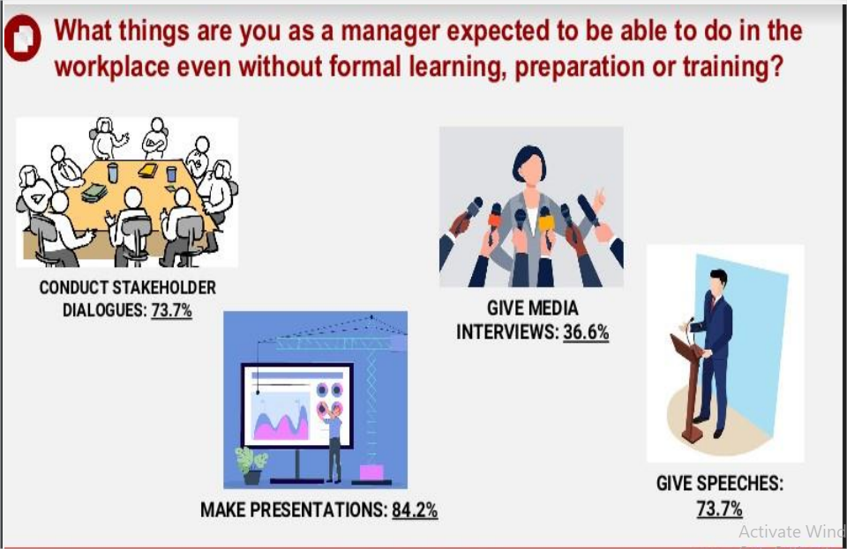
SCHOOLS DIVISION OF ILOCOS NORTE
RO1-SDOIN-F35-02-00
Effectivity Date: May 11, 2020
TITLE OF THE PRESENTATION

Slide 4
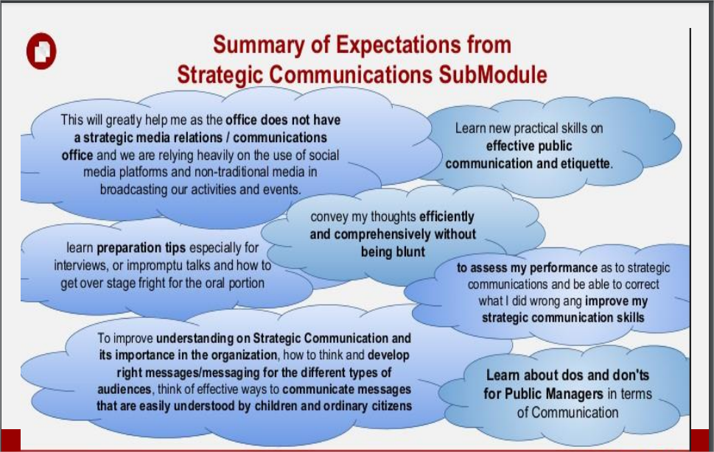
SCHOOLS DIVISION OF ILOCOS NORTE
RO1-SDOIN-F35-02-00
Effectivity Date: May 11, 2020
TITLE OF THE PRESENTATION

Slide 5
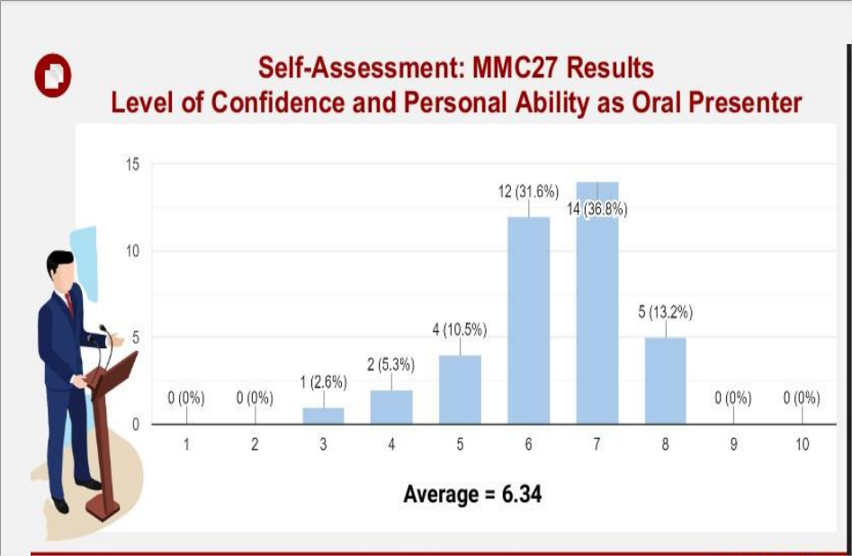
SCHOOLS DIVISION OF ILOCOS NORTE
RO1-SDOIN-F35-02-00
Effectivity Date: May 11, 2020
TITLE OF THE PRESENTATION

Slide 6
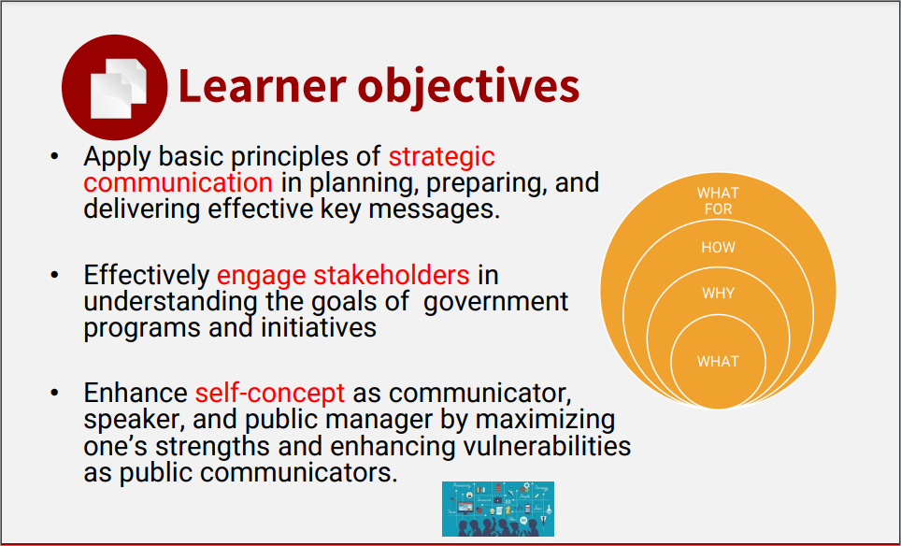
SCHOOLS DIVISION OF ILOCOS NORTE
RO1-SDOIN-F35-02-00
Effectivity Date: May 11, 2020
TITLE OF THE PRESENTATION

Slide 7
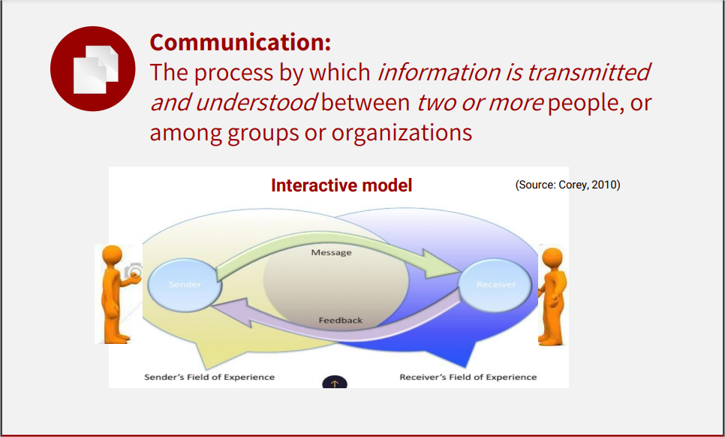
SCHOOLS DIVISION OF ILOCOS NORTE
RO1-SDOIN-F35-02-00
Effectivity Date: May 11, 2020
TITLE OF THE PRESENTATION

Slide 8
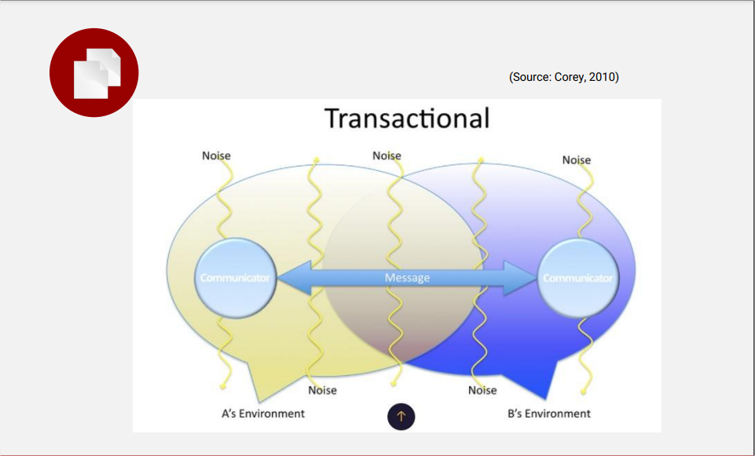
SCHOOLS DIVISION OF ILOCOS NORTE
RO1-SDOIN-F35-02-00
Effectivity Date: May 11, 2020
TITLE OF THE PRESENTATION

Slide 9
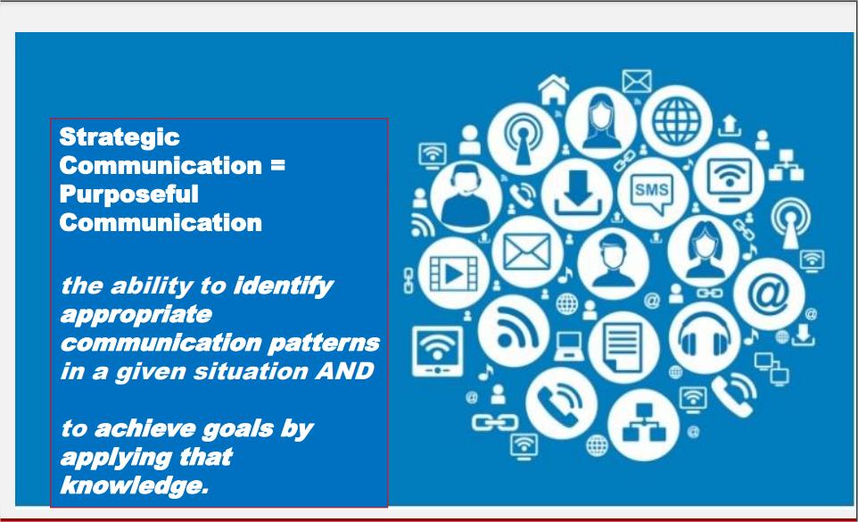
SCHOOLS DIVISION OF ILOCOS NORTE
RO1-SDOIN-F35-02-00
Effectivity Date: May 11, 2020
TITLE OF THE PRESENTATION

Slide 10

SCHOOLS DIVISION OF ILOCOS NORTE
RO1-SDOIN-F35-02-00
Effectivity Date: May 11, 2020
TITLE OF THE PRESENTATION

Slide 11
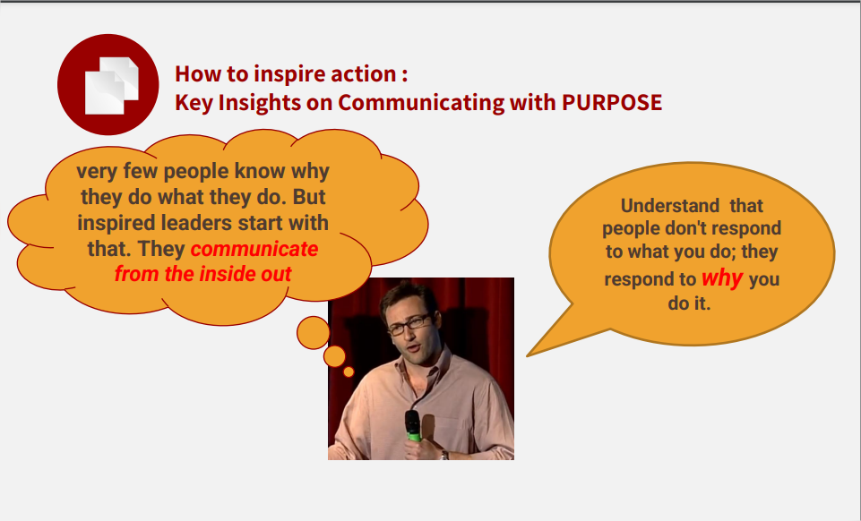
SCHOOLS DIVISION OF ILOCOS NORTE
RO1-SDOIN-F35-02-00
Effectivity Date: May 11, 2020
TITLE OF THE PRESENTATION

Slide 12

SCHOOLS DIVISION OF ILOCOS NORTE
RO1-SDOIN-F35-02-00
Effectivity Date: May 11, 2020
TITLE OF THE PRESENTATION

Slide 13
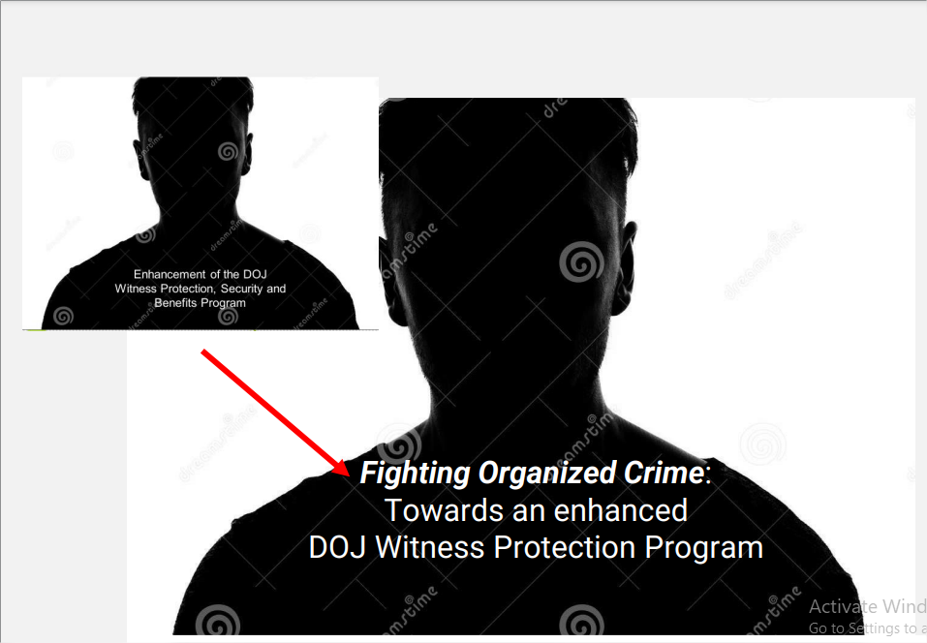
SCHOOLS DIVISION OF ILOCOS NORTE
RO1-SDOIN-F35-02-00
Effectivity Date: May 11, 2020
TITLE OF THE PRESENTATION

Slide 14

SCHOOLS DIVISION OF ILOCOS NORTE
RO1-SDOIN-F35-02-00
Effectivity Date: May 11, 2020
TITLE OF THE PRESENTATION

Slide 15
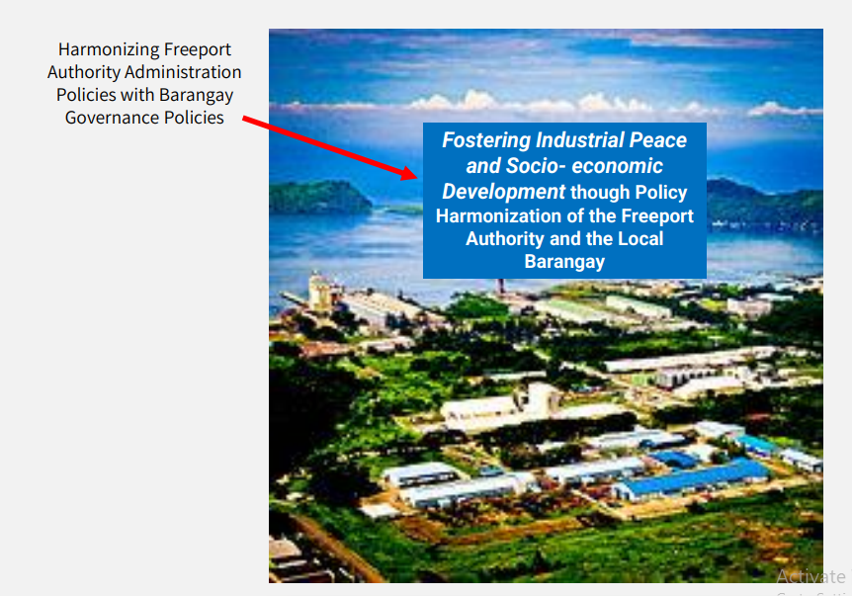
SCHOOLS DIVISION OF ILOCOS NORTE
RO1-SDOIN-F35-02-00
Effectivity Date: May 11, 2020
TITLE OF THE PRESENTATION

Slide 16
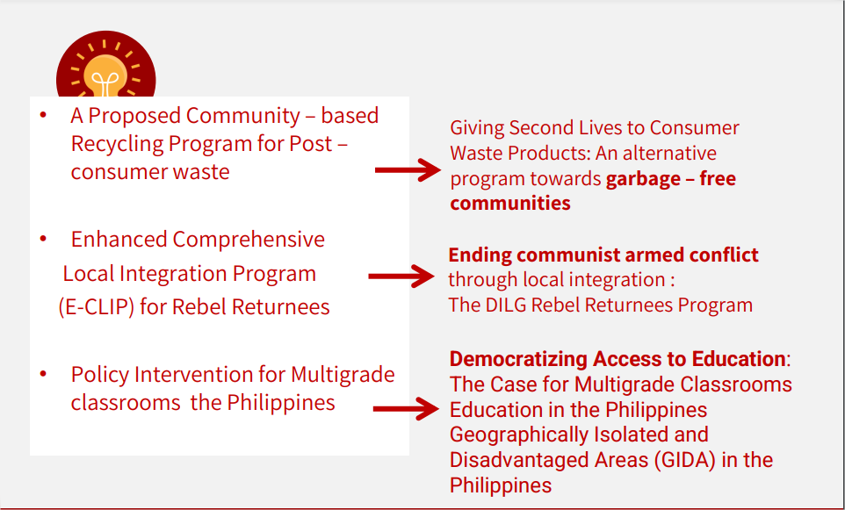
SCHOOLS DIVISION OF ILOCOS NORTE
RO1-SDOIN-F35-02-00
Effectivity Date: May 11, 2020
TITLE OF THE PRESENTATION

Slide 17
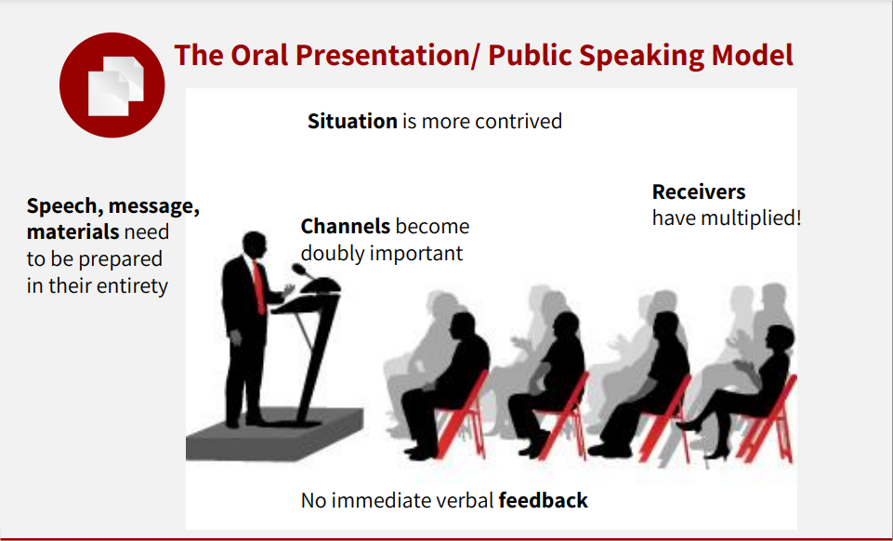
SCHOOLS DIVISION OF ILOCOS NORTE
RO1-SDOIN-F35-02-00
Effectivity Date: May 11, 2020
TITLE OF THE PRESENTATION

Slide 18
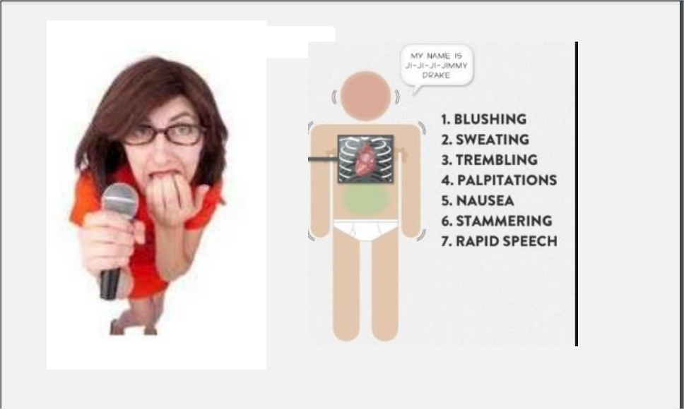
SCHOOLS DIVISION OF ILOCOS NORTE
RO1-SDOIN-F35-02-00
Effectivity Date: May 11, 2020
TITLE OF THE PRESENTATION

Slide 19

SCHOOLS DIVISION OF ILOCOS NORTE
RO1-SDOIN-F35-02-00
Effectivity Date: May 11, 2020
TITLE OF THE PRESENTATION

Slide 20
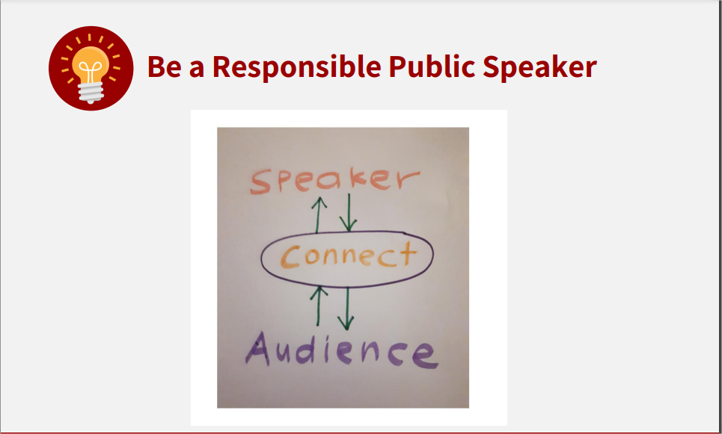
SCHOOLS DIVISION OF ILOCOS NORTE
RO1-SDOIN-F35-02-00
Effectivity Date: May 11, 2020
TITLE OF THE PRESENTATION

Slide 21
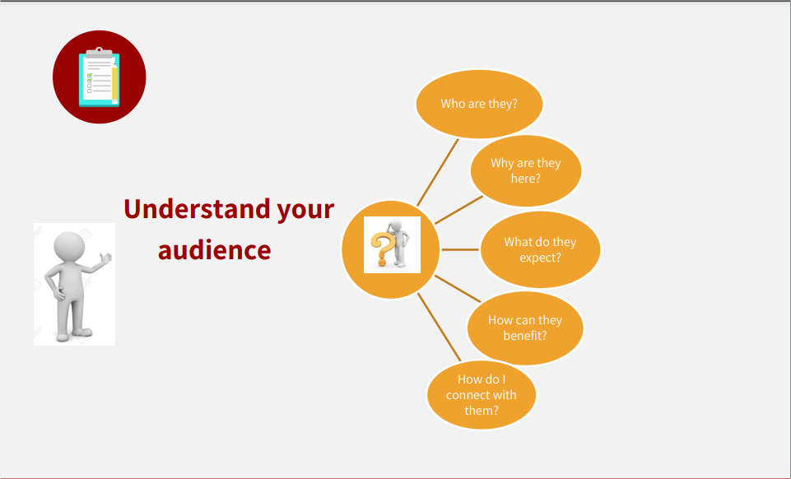
SCHOOLS DIVISION OF ILOCOS NORTE
RO1-SDOIN-F35-02-00
Effectivity Date: May 11, 2020
TITLE OF THE PRESENTATION

Slide 22
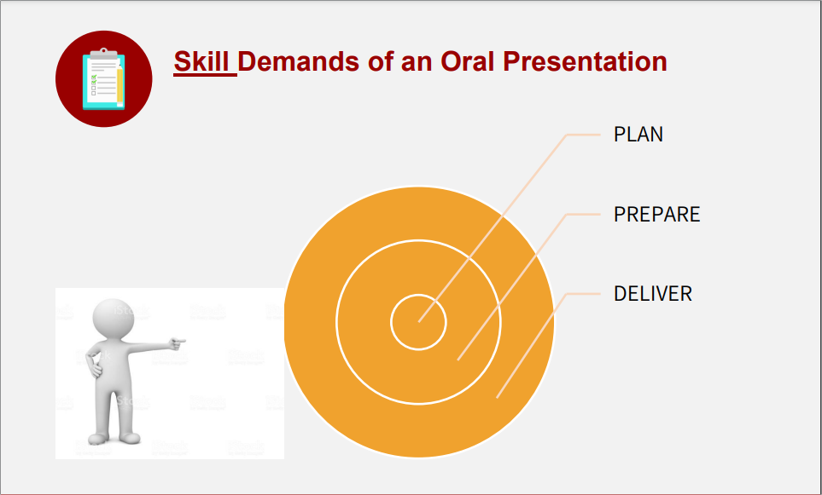
SCHOOLS DIVISION OF ILOCOS NORTE
RO1-SDOIN-F35-02-00
Effectivity Date: May 11, 2020
TITLE OF THE PRESENTATION

Slide 23
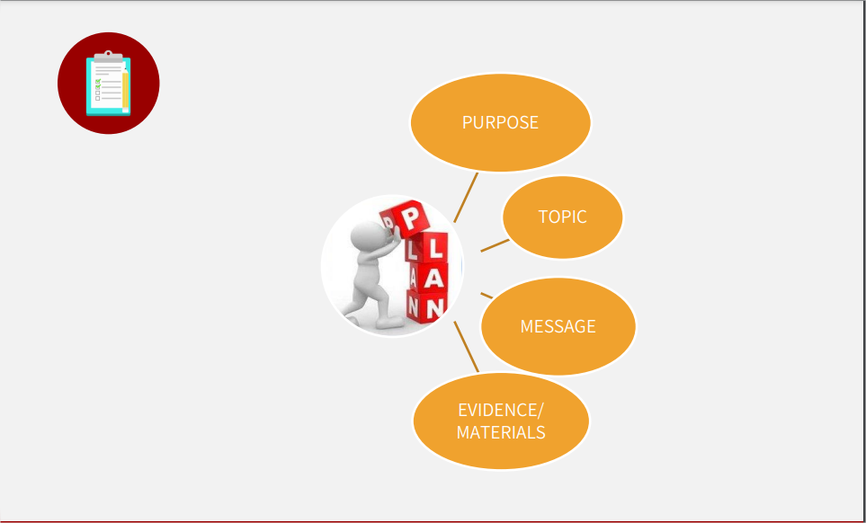
SCHOOLS DIVISION OF ILOCOS NORTE
RO1-SDOIN-F35-02-00
Effectivity Date: May 11, 2020
TITLE OF THE PRESENTATION

Slide 24
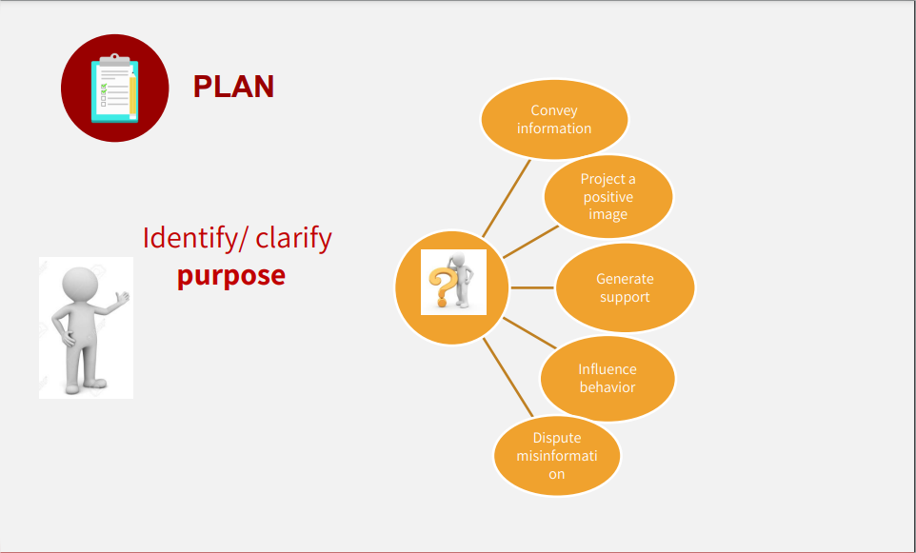
SCHOOLS DIVISION OF ILOCOS NORTE
RO1-SDOIN-F35-02-00
Effectivity Date: May 11, 2020
TITLE OF THE PRESENTATION

Slide 25
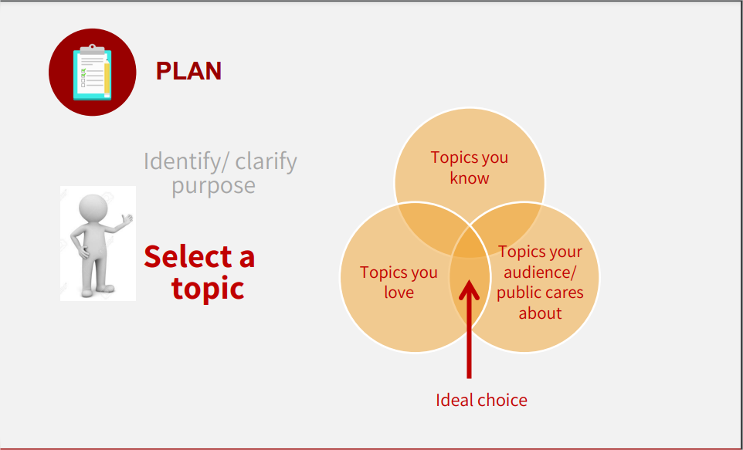
SCHOOLS DIVISION OF ILOCOS NORTE
RO1-SDOIN-F35-02-00
Effectivity Date: May 11, 2020
TITLE OF THE PRESENTATION

Slide 26
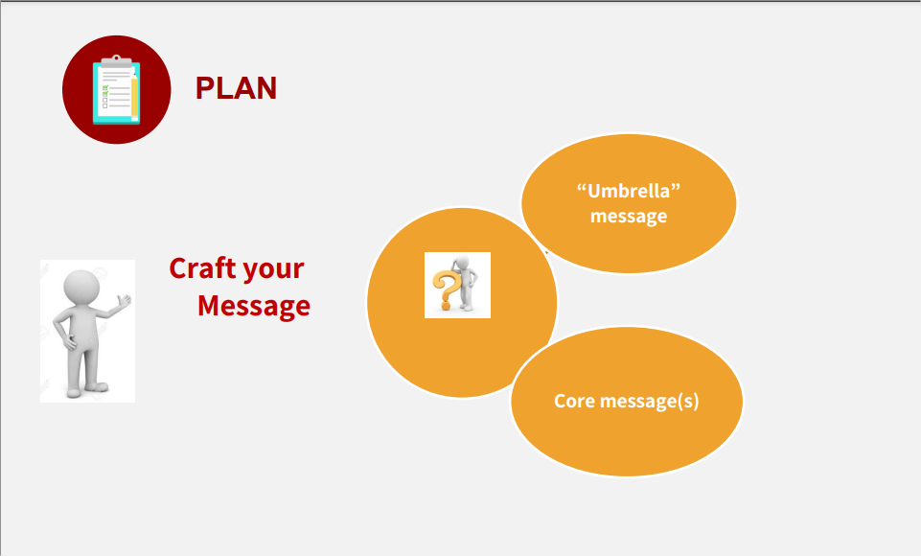
SCHOOLS DIVISION OF ILOCOS NORTE
RO1-SDOIN-F35-02-00
Effectivity Date: May 11, 2020
TITLE OF THE PRESENTATION

Slide 27
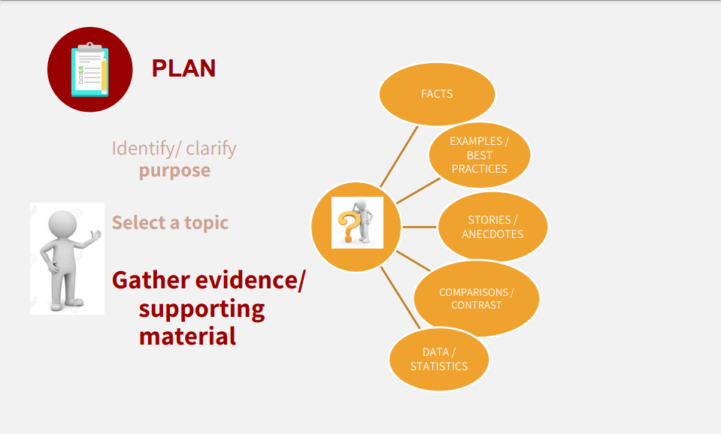
SCHOOLS DIVISION OF ILOCOS NORTE
RO1-SDOIN-F35-02-00
Effectivity Date: May 11, 2020
TITLE OF THE PRESENTATION

Slide 28
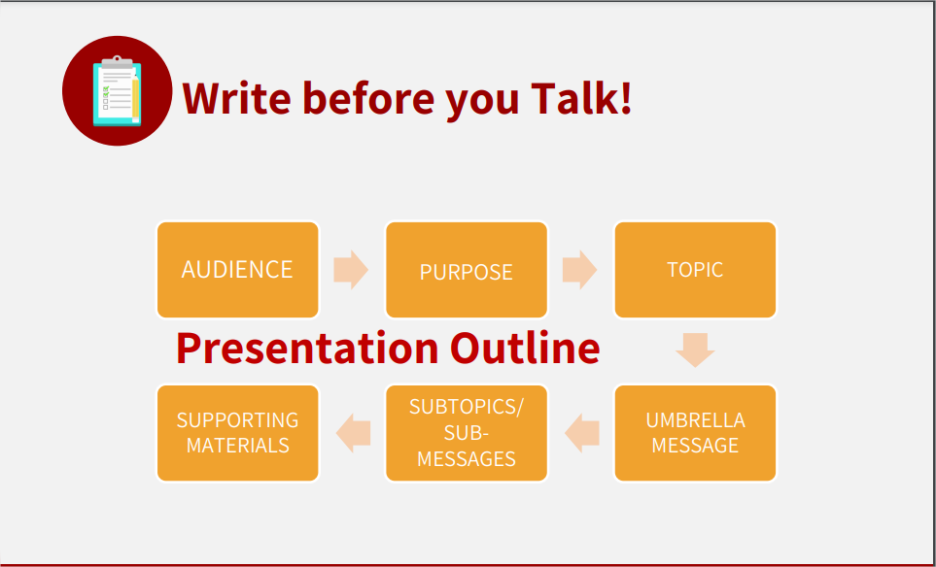
SCHOOLS DIVISION OF ILOCOS NORTE
RO1-SDOIN-F35-02-00
Effectivity Date: May 11, 2020
TITLE OF THE PRESENTATION

Slide 29

SCHOOLS DIVISION OF ILOCOS NORTE
RO1-SDOIN-F35-02-00
Effectivity Date: May 11, 2020
TITLE OF THE PRESENTATION

Slide 30
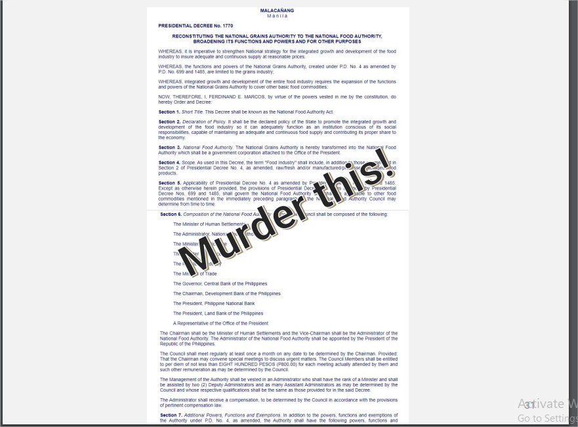
SCHOOLS DIVISION OF ILOCOS NORTE
RO1-SDOIN-F35-02-00
Effectivity Date: May 11, 2020
TITLE OF THE PRESENTATION

Slide 31
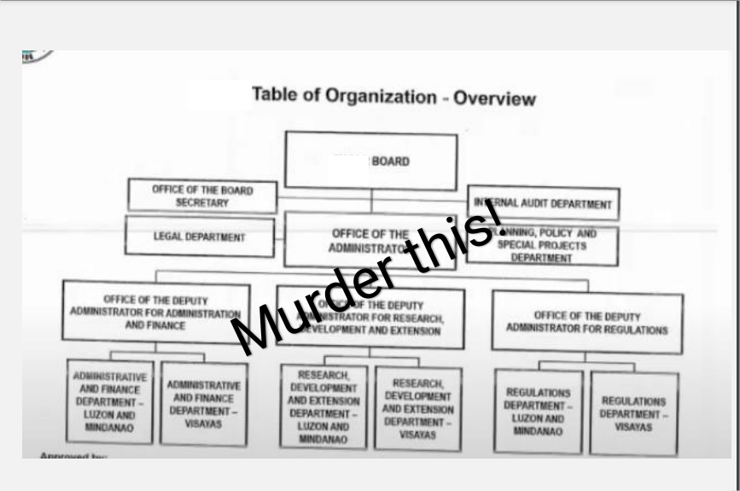
SCHOOLS DIVISION OF ILOCOS NORTE
RO1-SDOIN-F35-02-00
Effectivity Date: May 11, 2020
TITLE OF THE PRESENTATION

Slide 32
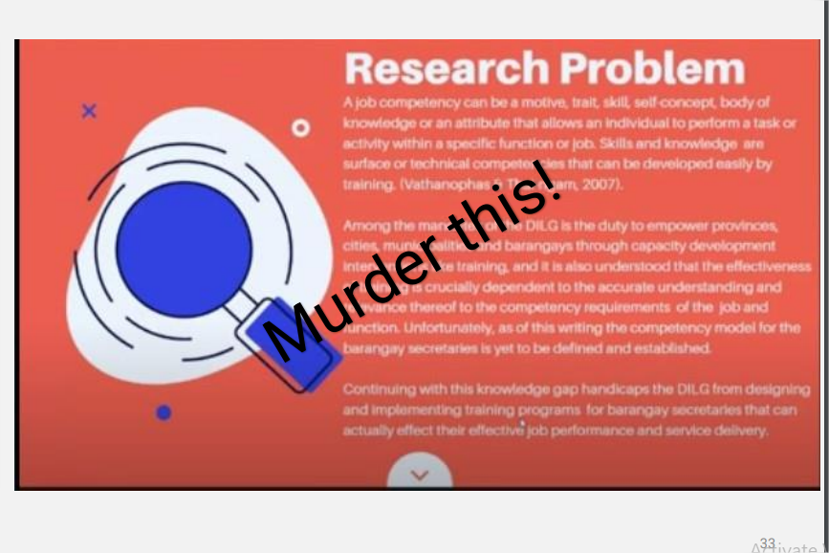
SCHOOLS DIVISION OF ILOCOS NORTE
RO1-SDOIN-F35-02-00
Effectivity Date: May 11, 2020
TITLE OF THE PRESENTATION

Slide 33
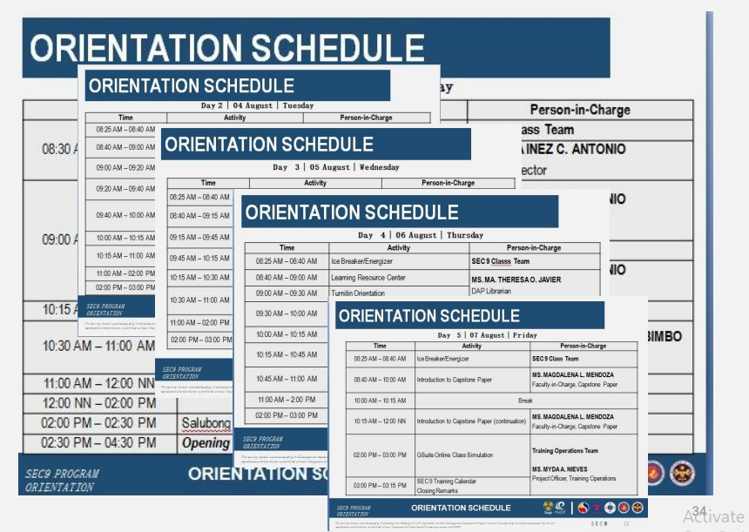
SCHOOLS DIVISION OF ILOCOS NORTE
RO1-SDOIN-F35-02-00
Effectivity Date: May 11, 2020
TITLE OF THE PRESENTATION

Slide 34
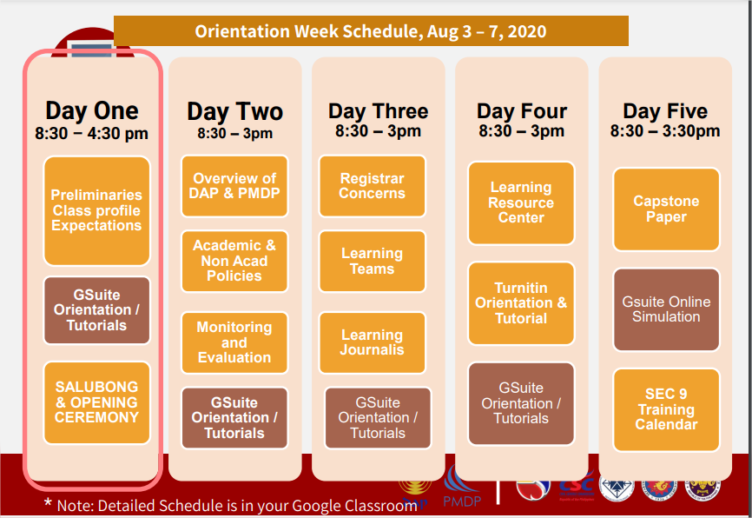
SCHOOLS DIVISION OF ILOCOS NORTE
RO1-SDOIN-F35-02-00
Effectivity Date: May 11, 2020
TITLE OF THE PRESENTATION

Slide 35
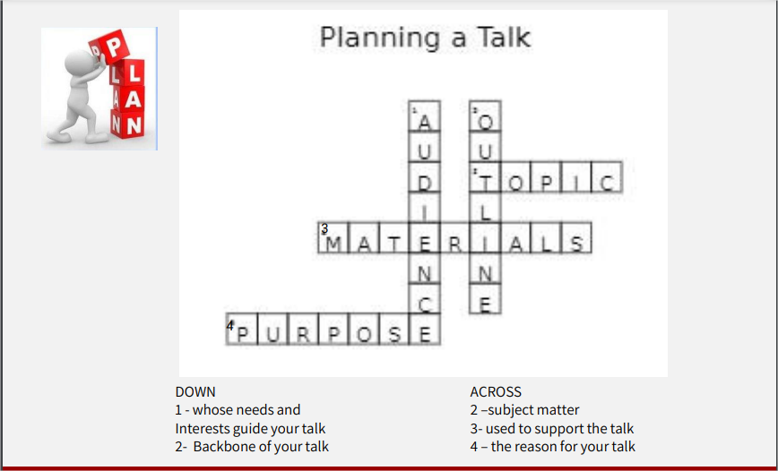
SCHOOLS DIVISION OF ILOCOS NORTE
RO1-SDOIN-F35-02-00
Effectivity Date: May 11, 2020
TITLE OF THE PRESENTATION

Slide 36
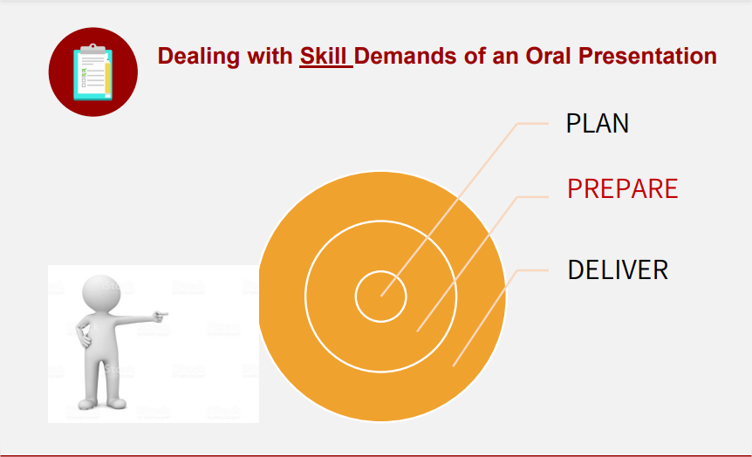
SCHOOLS DIVISION OF ILOCOS NORTE
RO1-SDOIN-F35-02-00
Effectivity Date: May 11, 2020
TITLE OF THE PRESENTATION

Slide 37
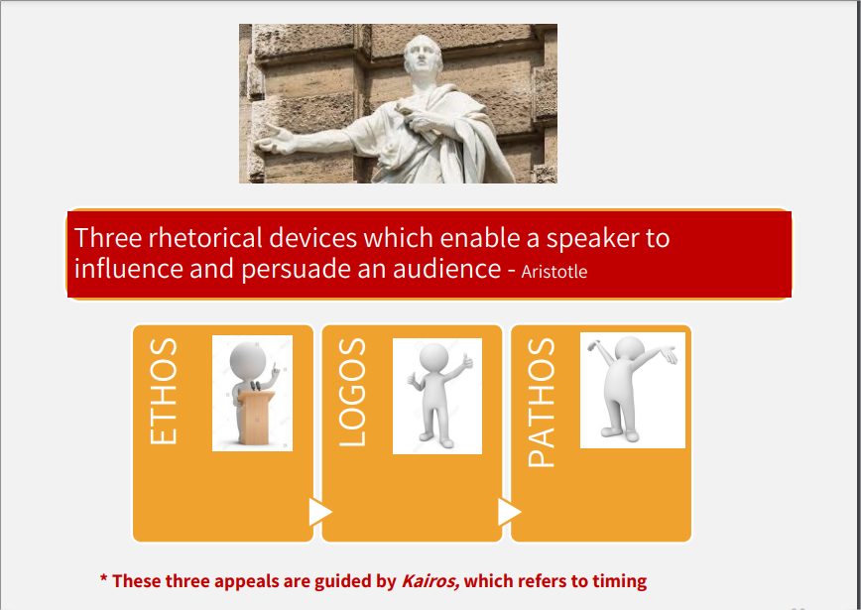
SCHOOLS DIVISION OF ILOCOS NORTE
RO1-SDOIN-F35-02-00
Effectivity Date: May 11, 2020
TITLE OF THE PRESENTATION

Slide 38
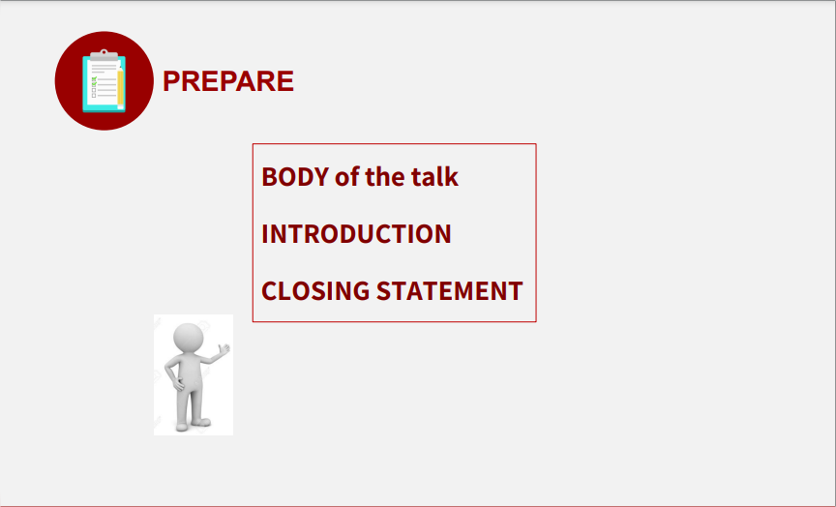
SCHOOLS DIVISION OF ILOCOS NORTE
RO1-SDOIN-F35-02-00
Effectivity Date: May 11, 2020
TITLE OF THE PRESENTATION

Slide 39
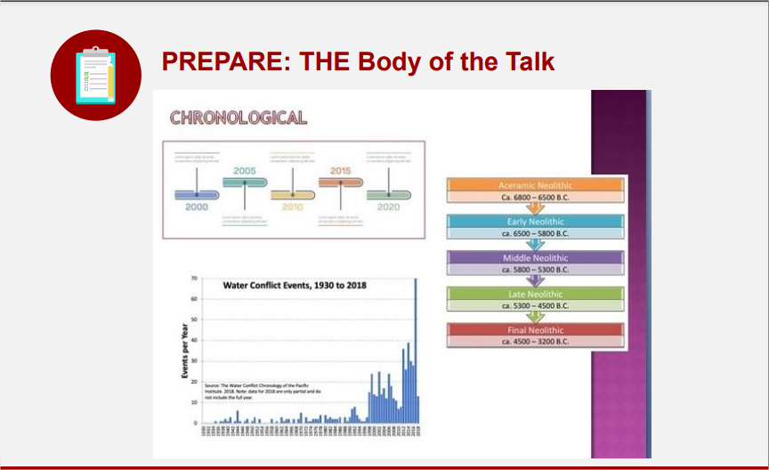
SCHOOLS DIVISION OF ILOCOS NORTE
RO1-SDOIN-F35-02-00
Effectivity Date: May 11, 2020
TITLE OF THE PRESENTATION

Slide 40
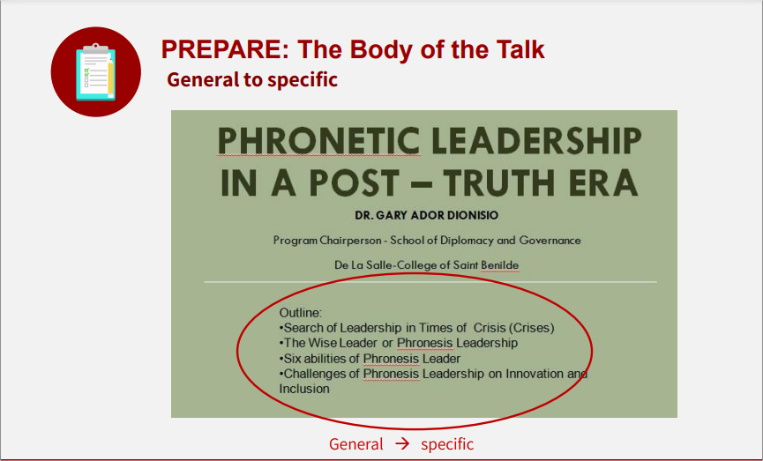
SCHOOLS DIVISION OF ILOCOS NORTE
RO1-SDOIN-F35-02-00
Effectivity Date: May 11, 2020
TITLE OF THE PRESENTATION

Slide 41
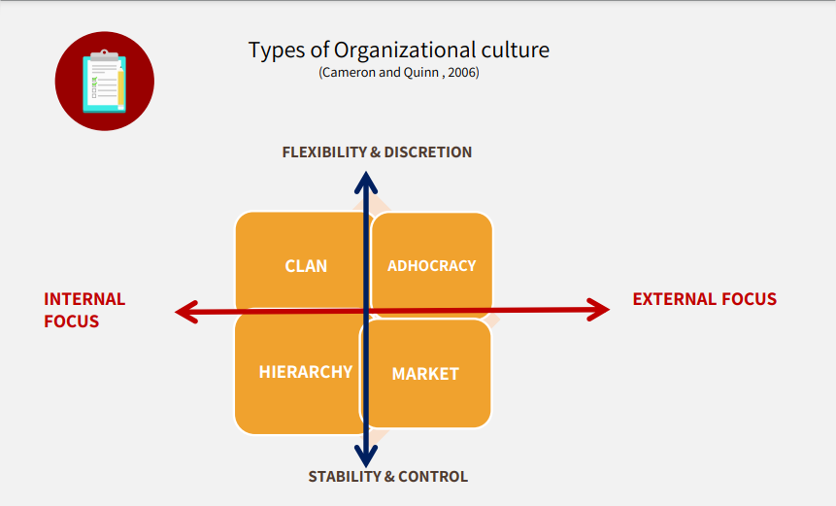
SCHOOLS DIVISION OF ILOCOS NORTE
RO1-SDOIN-F35-02-00
Effectivity Date: May 11, 2020
TITLE OF THE PRESENTATION

Slide 42
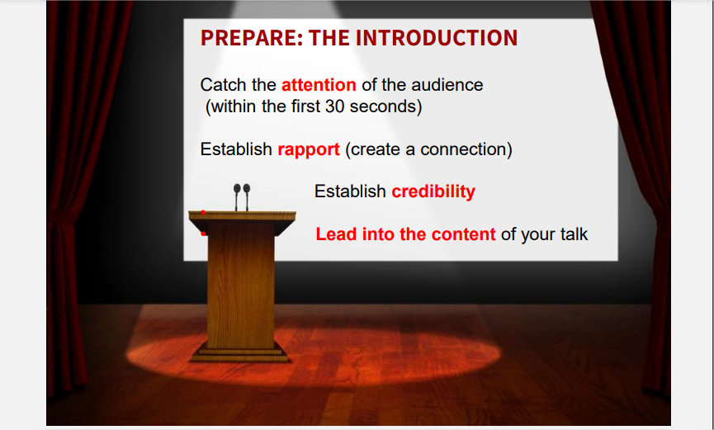
SCHOOLS DIVISION OF ILOCOS NORTE
RO1-SDOIN-F35-02-00
Effectivity Date: May 11, 2020
TITLE OF THE PRESENTATION

Slide 43
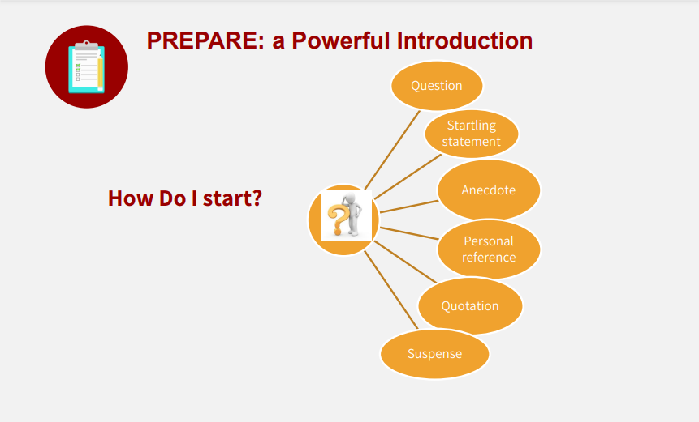
SCHOOLS DIVISION OF ILOCOS NORTE
RO1-SDOIN-F35-02-00
Effectivity Date: May 11, 2020
TITLE OF THE PRESENTATION

Slide 44
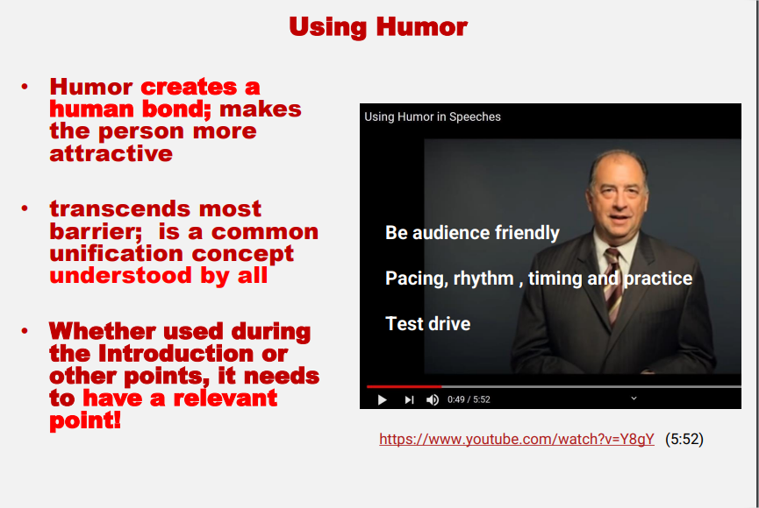
SCHOOLS DIVISION OF ILOCOS NORTE
RO1-SDOIN-F35-02-00
Effectivity Date: May 11, 2020
TITLE OF THE PRESENTATION

Slide 45
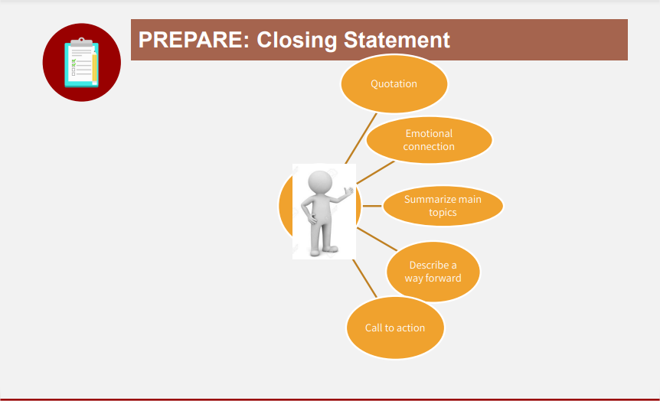
SCHOOLS DIVISION OF ILOCOS NORTE
RO1-SDOIN-F35-02-00
Effectivity Date: May 11, 2020
TITLE OF THE PRESENTATION

Slide 46
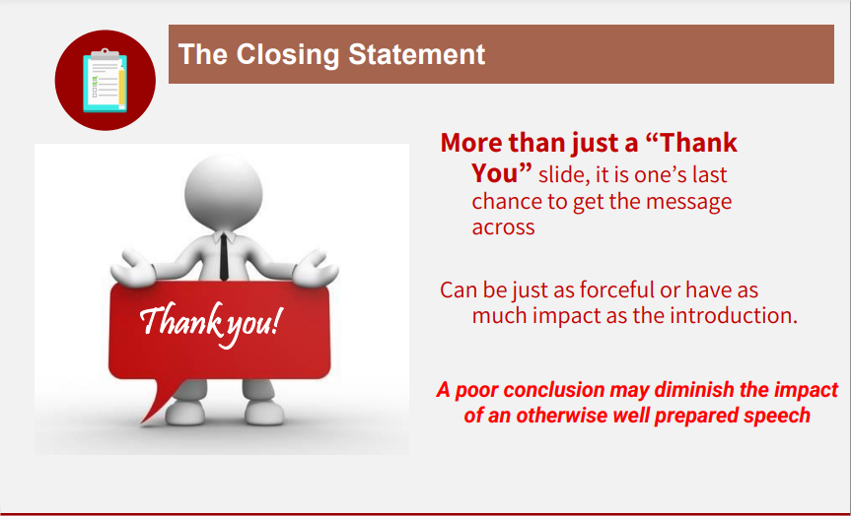
SCHOOLS DIVISION OF ILOCOS NORTE
RO1-SDOIN-F35-02-00
Effectivity Date: May 11, 2020
TITLE OF THE PRESENTATION

Slide 47
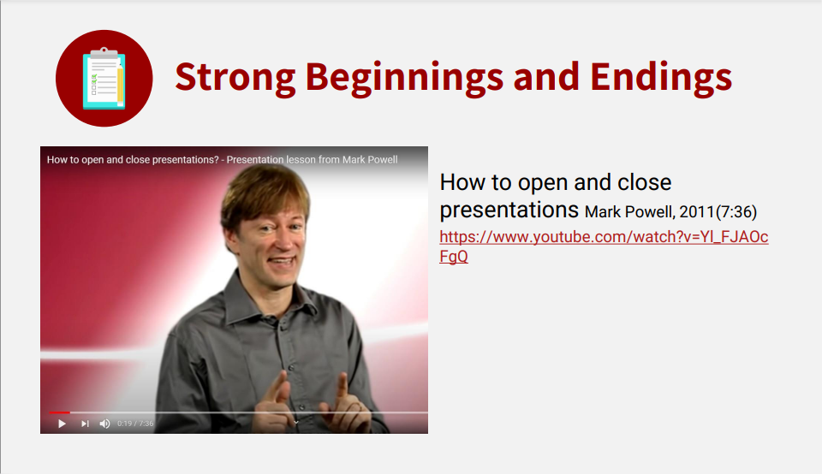
SCHOOLS DIVISION OF ILOCOS NORTE
RO1-SDOIN-F35-02-00
Effectivity Date: May 11, 2020
TITLE OF THE PRESENTATION

Slide 48
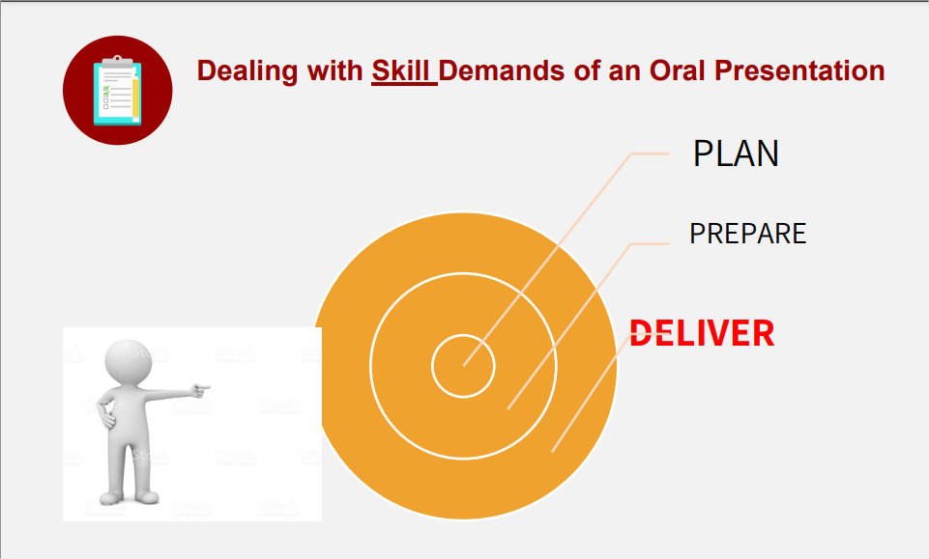
SCHOOLS DIVISION OF ILOCOS NORTE
RO1-SDOIN-F35-02-00
Effectivity Date: May 11, 2020
TITLE OF THE PRESENTATION

Slide 49

SCHOOLS DIVISION OF ILOCOS NORTE
RO1-SDOIN-F35-02-00
Effectivity Date: May 11, 2020
TITLE OF THE PRESENTATION

Slide 50

SCHOOLS DIVISION OF ILOCOS NORTE
RO1-SDOIN-F35-02-00
Effectivity Date: May 11, 2020
TITLE OF THE PRESENTATION

Slide 51

SCHOOLS DIVISION OF ILOCOS NORTE
RO1-SDOIN-F35-02-00
Effectivity Date: May 11, 2020
TITLE OF THE PRESENTATION

Slide 52
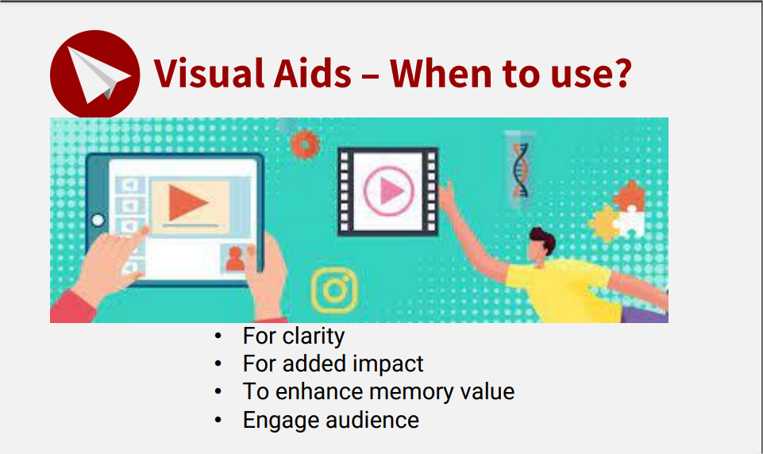
SCHOOLS DIVISION OF ILOCOS NORTE
RO1-SDOIN-F35-02-00
Effectivity Date: May 11, 2020
TITLE OF THE PRESENTATION

Slide 53
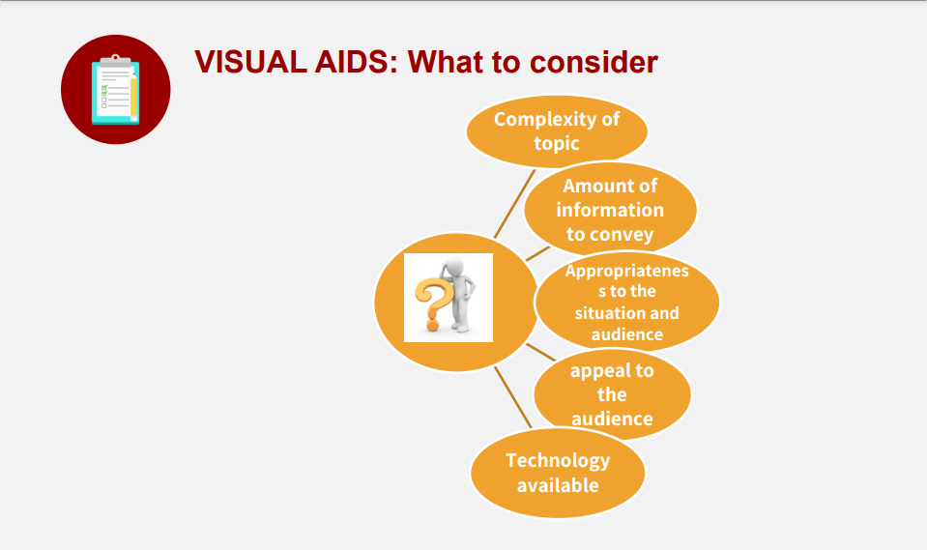
SCHOOLS DIVISION OF ILOCOS NORTE
RO1-SDOIN-F35-02-00
Effectivity Date: May 11, 2020
TITLE OF THE PRESENTATION

Slide 54
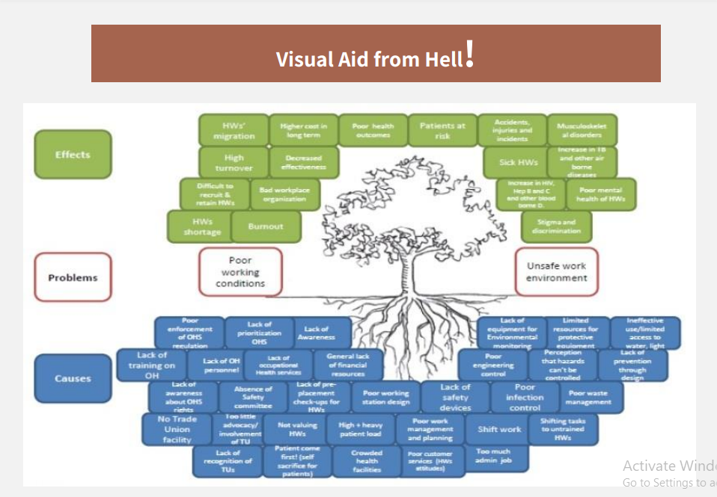
SCHOOLS DIVISION OF ILOCOS NORTE
RO1-SDOIN-F35-02-00
Effectivity Date: May 11, 2020
TITLE OF THE PRESENTATION

Slide 55
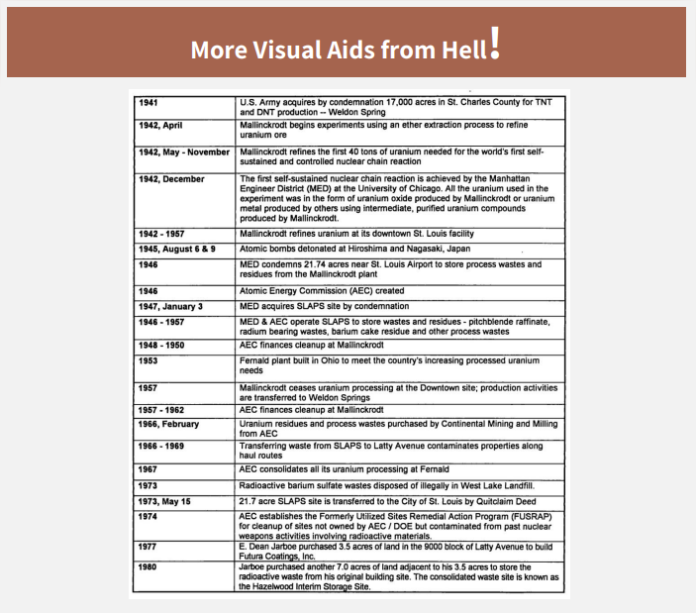
SCHOOLS DIVISION OF ILOCOS NORTE
RO1-SDOIN-F35-02-00
Effectivity Date: May 11, 2020
TITLE OF THE PRESENTATION

Slide 56
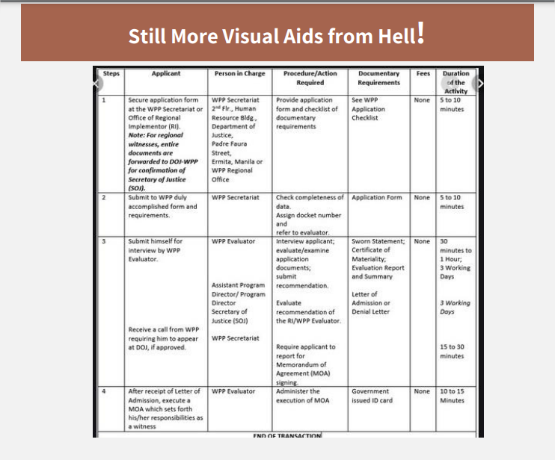
SCHOOLS DIVISION OF ILOCOS NORTE
RO1-SDOIN-F35-02-00
Effectivity Date: May 11, 2020
TITLE OF THE PRESENTATION

Slide 57
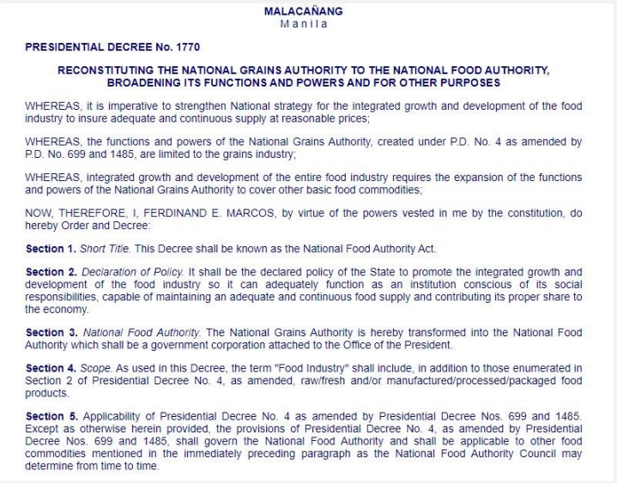
SCHOOLS DIVISION OF ILOCOS NORTE
RO1-SDOIN-F35-02-00
Effectivity Date: May 11, 2020
TITLE OF THE PRESENTATION

Slide 58
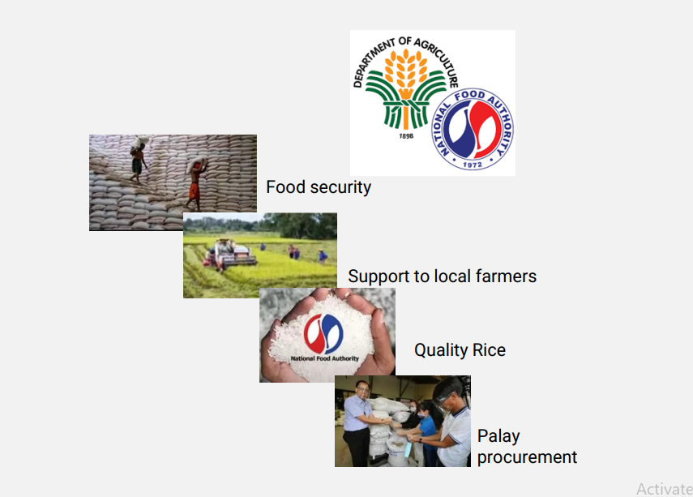
SCHOOLS DIVISION OF ILOCOS NORTE
RO1-SDOIN-F35-02-00
Effectivity Date: May 11, 2020
TITLE OF THE PRESENTATION

Slide 59
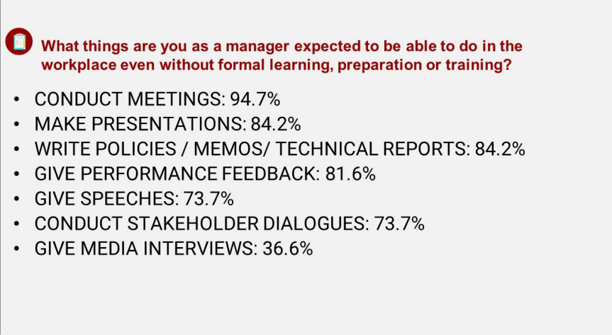
SCHOOLS DIVISION OF ILOCOS NORTE
RO1-SDOIN-F35-02-00
Effectivity Date: May 11, 2020
TITLE OF THE PRESENTATION

Slide 60

SCHOOLS DIVISION OF ILOCOS NORTE
RO1-SDOIN-F35-02-00
Effectivity Date: May 11, 2020
TITLE OF THE PRESENTATION

Slide 61

SCHOOLS DIVISION OF ILOCOS NORTE
RO1-SDOIN-F35-02-00
Effectivity Date: May 11, 2020
TITLE OF THE PRESENTATION

Slide 62

SCHOOLS DIVISION OF ILOCOS NORTE
RO1-SDOIN-F35-02-00
Effectivity Date: May 11, 2020
TITLE OF THE PRESENTATION

Slide 63

SCHOOLS DIVISION OF ILOCOS NORTE
RO1-SDOIN-F35-02-00
Effectivity Date: May 11, 2020
TITLE OF THE PRESENTATION

Slide 64

SCHOOLS DIVISION OF ILOCOS NORTE
RO1-SDOIN-F35-02-00
Effectivity Date: May 11, 2020
TITLE OF THE PRESENTATION

Slide 65

SCHOOLS DIVISION OF ILOCOS NORTE
RO1-SDOIN-F35-02-00
Effectivity Date: May 11, 2020
TITLE OF THE PRESENTATION

Slide 66

SCHOOLS DIVISION OF ILOCOS NORTE
RO1-SDOIN-F35-02-00
Effectivity Date: May 11, 2020
TITLE OF THE PRESENTATION

Slide 67

SCHOOLS DIVISION OF ILOCOS NORTE
RO1-SDOIN-F35-02-00
Effectivity Date: May 11, 2020
TITLE OF THE PRESENTATION

Slide 68

SCHOOLS DIVISION OF ILOCOS NORTE
RO1-SDOIN-F35-02-00
Effectivity Date: May 11, 2020
TITLE OF THE PRESENTATION

Slide 69

SCHOOLS DIVISION OF ILOCOS NORTE
RO1-SDOIN-F35-02-00
Effectivity Date: May 11, 2020
TITLE OF THE PRESENTATION

Slide 70

SCHOOLS DIVISION OF ILOCOS NORTE
RO1-SDOIN-F35-02-00
Effectivity Date: May 11, 2020
TITLE OF THE PRESENTATION

Slide 71

SCHOOLS DIVISION OF ILOCOS NORTE
RO1-SDOIN-F35-02-00
Effectivity Date: May 11, 2020
TITLE OF THE PRESENTATION

Slide 72

SCHOOLS DIVISION OF ILOCOS NORTE
RO1-SDOIN-F35-02-00
Effectivity Date: May 11, 2020
TITLE OF THE PRESENTATION

Slide 73

SCHOOLS DIVISION OF ILOCOS NORTE
RO1-SDOIN-F35-02-00
Effectivity Date: May 11, 2020
TITLE OF THE PRESENTATION

